Slide 1
Amazon sales analysis
Presented by – upputholla soujanyasri

Slide 2
introduction
Sales management has gained importance to meet increasing competition and the need for improved methods of distribution to reduce costs and increase profits. Sales management today is the most important function in a commercial and business enterprise.
Sales analytics is the method by which sales data is collected and analyzed to improve sales performance and increase revenue.

Slide 3

Main kpi’s
Total Revenue
Quantity Sold
Total Cost
Total Profit

Slide 4
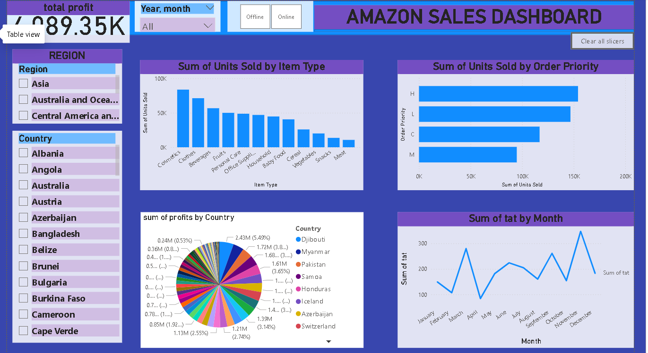
55m 23s
000.000
000 km
MENU
ANALYSIS
CONTACT
Data ANALYSIS
9H
is Jupiter's rotation period
333,
earths is the Sun’s mass
386,
is the distance between Earth and the Moon

Slide 5
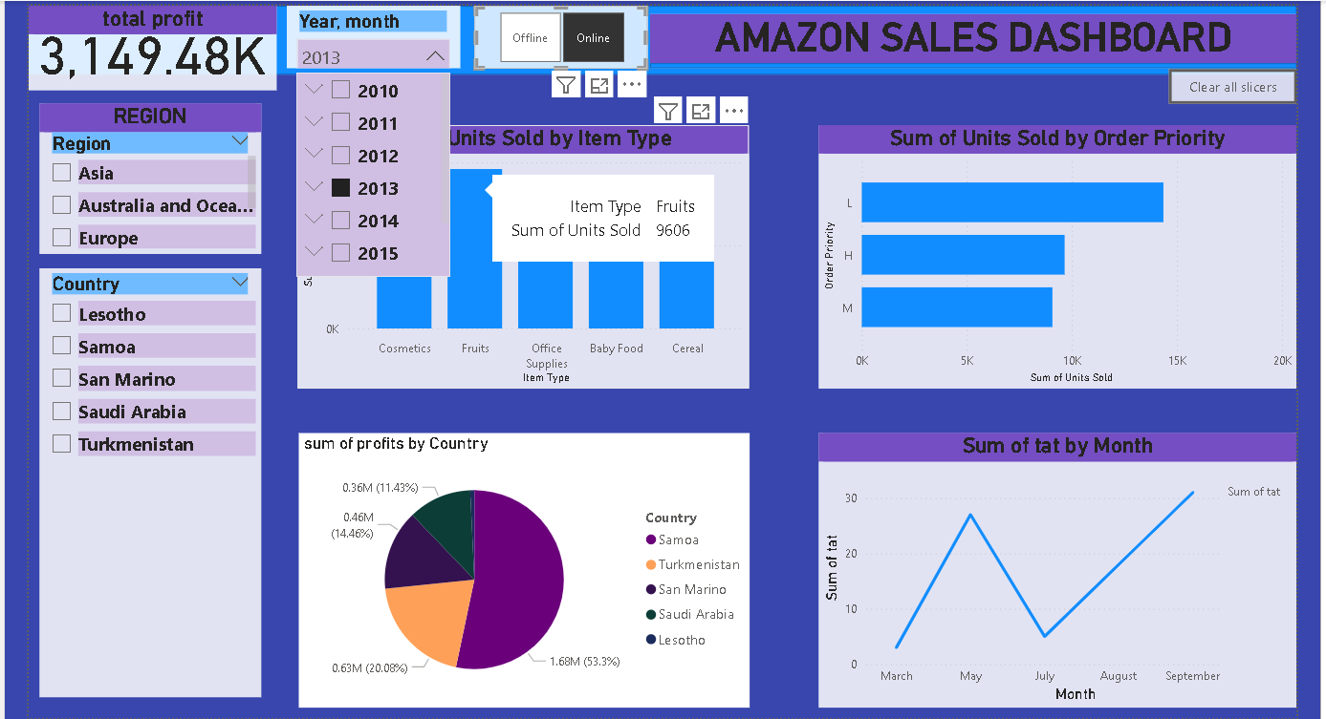
55m 23s
000.000
000 km
MENU
ANALYSIS
CONTACT
Data ANALYSIS
9H
is Jupiter's rotation period
333,
earths is the Sun’s mass
386,
is the distance between Earth and the Moon

Slide 6
Insights generated
>> Top 5 Gross Profit Margin Categories: Cosmetics, Households, Office Supplies, Clothes, and Baby Food are the top-performing categories in terms of gross profit margin >> Profit Percentage by Sales Channels: Online sales contribute to 44% of the total profit, while offline sales contribute to the remaining 56% >> Profit Percentage by Customer Preferences: High-priority customer preferences generate 38% of the total profit, followed by the least priority (25%), medium (22%), and cancels (15%).

Slide 7
Insights generated
Monthly Trends: February, July, and November exhibit the highest number of orders, while March, June, and August show the Lowest order volumes.
Profit Percentage by Regions : Europe and Sub-Saharan Africa are the most profitable regions, contributing 25% and 28% respectively to the total profit. Other significant regions include Asia (14%), Australia and Oceania (11%), Central America and the Caribbean (6%), and Middle East & North America (13%).
Most Profitable Countries : Djibouti and Myanmar emerge as the most profitable countries within the regions analyzed.

Slide 8
THANK YOU

